Slide 1
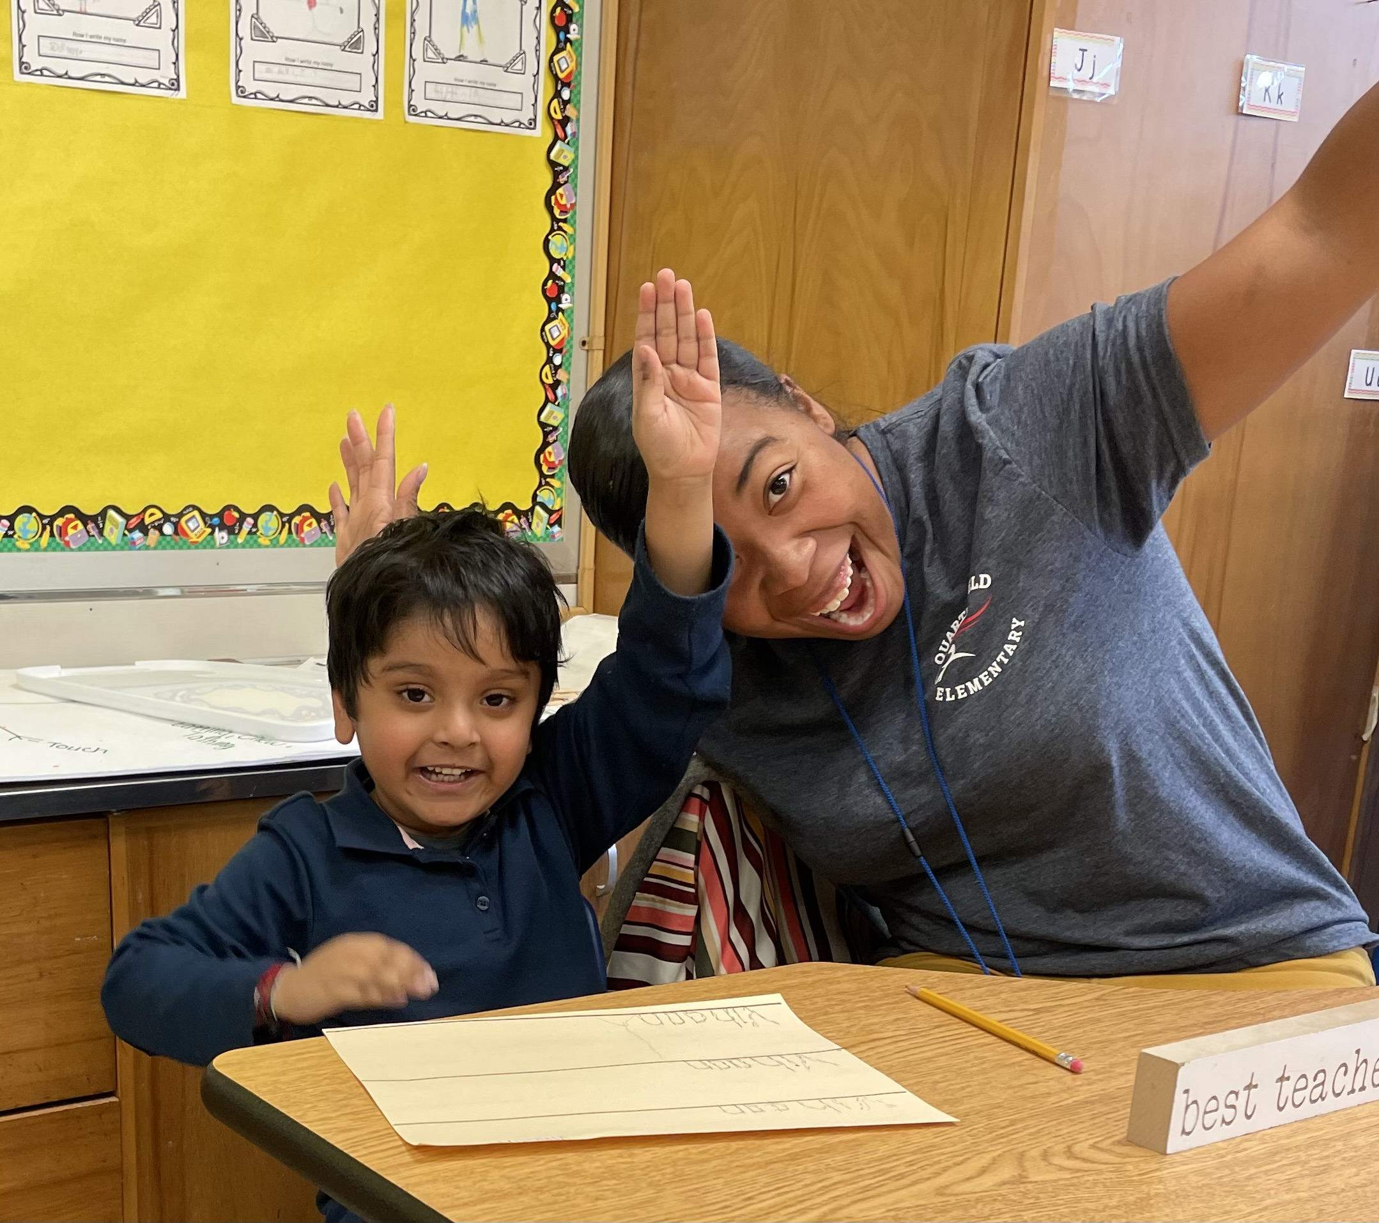
Quarterfield’s Sunday Newsletter
Issued: Sunday, September 18th
Monday, September 19th | Tuesday, September 20th | Wednesday, September 21th | Thursday, September 22th | Friday, September 23th
Arrival 7:45 Dismissal 2:25 | Arrival 7:45 Dismissal 2:25 | Arrival 7:45 Dismissal 2:25 | Arrival 7:45 Dismissal 2:25 | Arrival 7:45 Dismissal 2:25
School Lunch Week of Sept. 19th
Mon: Chicken Drumstick w/Rounds
Tues:Taco w/Tortilla & Scoops
Wed: Penne Alfredo w/Garlic Bread Stick
Thurs: Popcorn Chicken w/Rounds
Fri: Garlic French Bread Pizza
9/29/2022
(Students will wear uniform)
Pre-order Before Picture Day
https://classicphotographyimaging.simplephoto.com/search/quarterfield2022
News from MEDIA
Grades 3-5 began checking out books and
reviewing book care! Primary grades will
begin soon. Click to see when your child's class will be checking out/returning books and click to review library book care at home. Happy Reading QES! - Ms. Zacks (Media Specialist)
Join Our Fabulous PTA
Miss the last meeting? No problem! View the minutes here! Next meeting Wednesday, Oct. 19th.
Looking Ahead:
September
24 | Pop Up Pantry QES @ 10:30
26 | Schools & Central Offices closed. Rosh Hashannah
29| School Picture Day
Click here to order your
QES Spirit Wear
Quarterfield’s Tweet of the Week!
School Supplies
Students should bring a water bottle each day.
Students in Grades 3-5 should bring charged chromebooks daily.
Transportation changes should only be made in the case of an EMERGENCY!
Students arriving after 8:00 AM will be marked TARDY!

